Slide 1
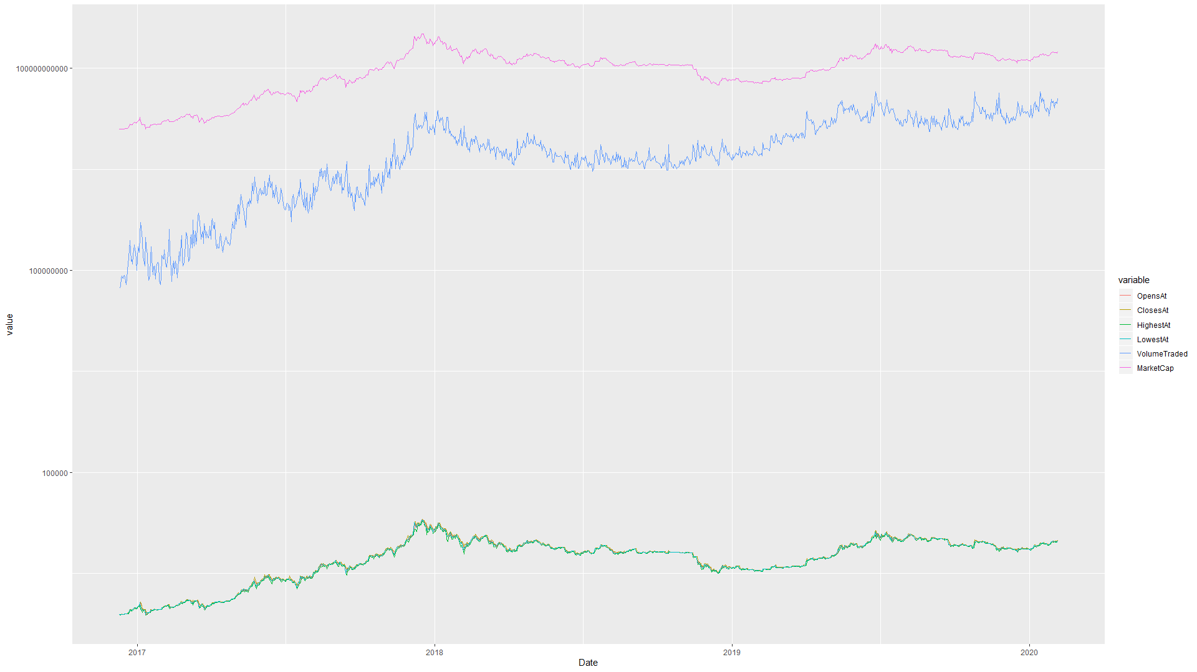
Hugo Joncour - 40139130 Zié Coulibaly - 40046155
Can we predict Tether’s market cap evolution using other cryptocurrencies’s demand ?

Slide 2
Index:
Introduction
Research project: Part 1
What ?
Why ?
Research project: Part 2
The data
First results
Research project: Part 3
Machine Learning Models
Results
Conclusion

Slide 3









Cryptocurrencies

Slide 4
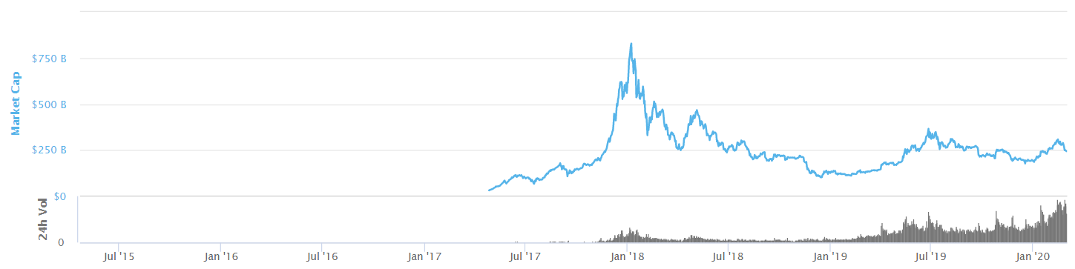
Cryptocurrencies
> 5000 cryptocurrencies
> 20 000 different markets
Volume traded every 24 hours > 125 billion USD
Global Market Cap > 250 billion dollars

Slide 5




Cryptocurrencies
How to trade cryptocurrencies ?
To buy crypto
Conversion fees to change $/€ to cryptocurrencies
Transaction fees to send your money out of a platform
To secure value

Slide 6
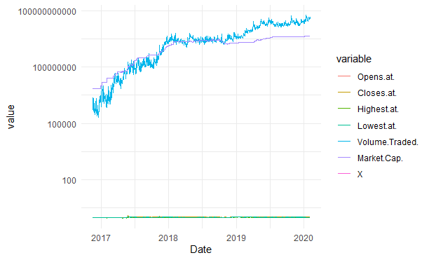

The Tether - USDT
Market cap: 4 628 311 000$
Volume Traded in 24h: 51 142 268 000$
35% of volume traded every day
1 USDT = 1USD

Slide 7
Cryptocurrencies
How to trade cryptocurrencies ?
To buy crypto
Conversion fees to change $/€ to cryptocurrencies
Transaction fees to send your money out of a platform
To secure value
Almost no fees
Almost instantaneous

Slide 8
Research Project: Presentation
Can we predict Tether’s market cap evolution using other cryptocurrencies’s demand ?

Slide 9
Research Project: Presentation
Can we predict Tether’s market cap evolution using other cryptocurrencies’s demand ?
What does it mean ?

Slide 10
Research Project: Presentation
Can we predict Tether’s market cap evolution using other cryptocurrencies’s demand ?
What does it mean ?
Why ?

Slide 11

Research Project: The Data
For this project we used Coinmarketcap’s data
> 5000 currencies
> 300 platforms

Slide 12
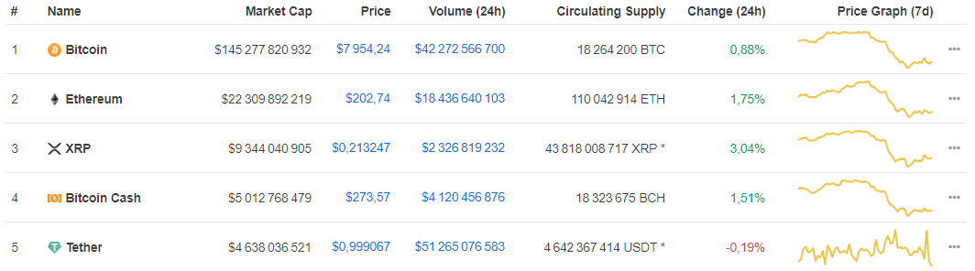
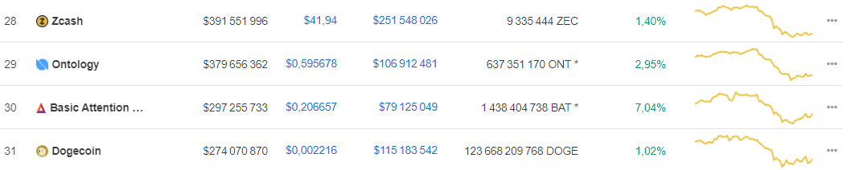
Research Project: The Data

Slide 13
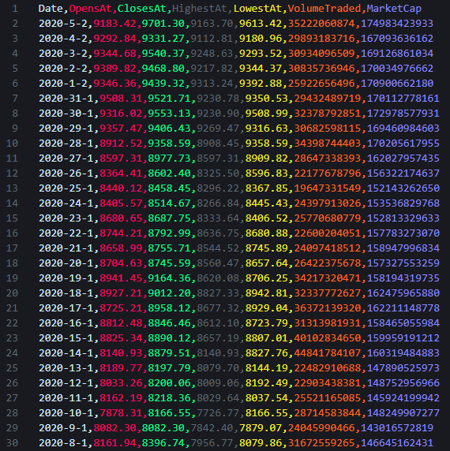
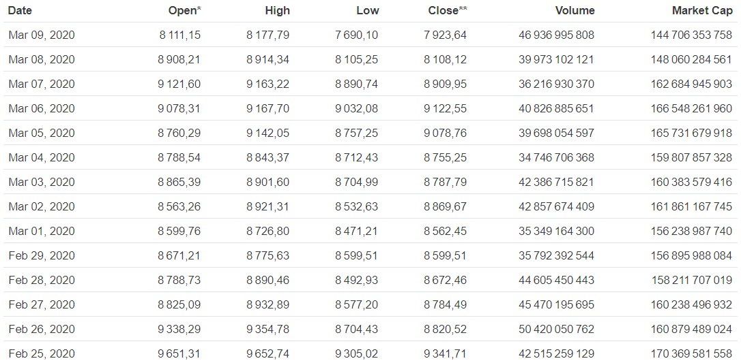
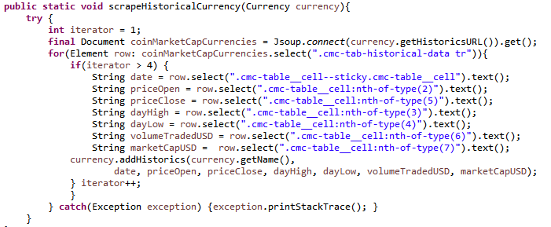
Research Project: The Data

Slide 14
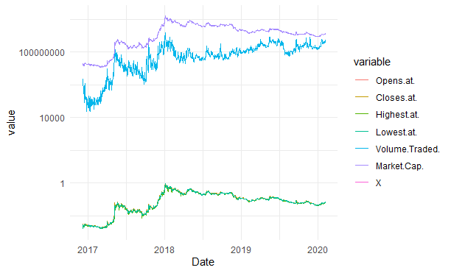
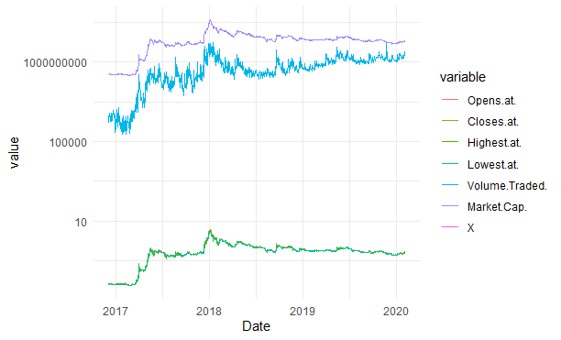

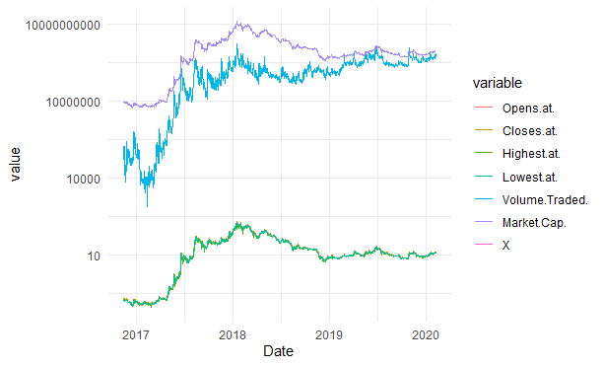
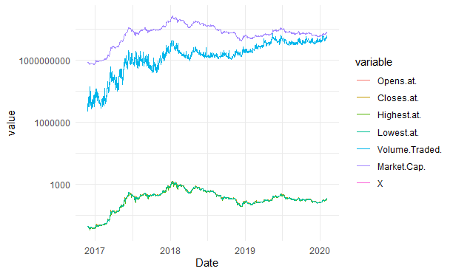

Research Project: The Data
Stellar
Ripple
Neo
Ethereum

Slide 15
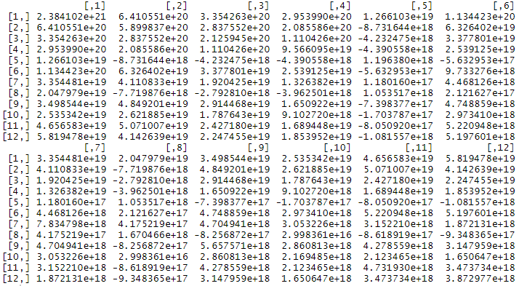
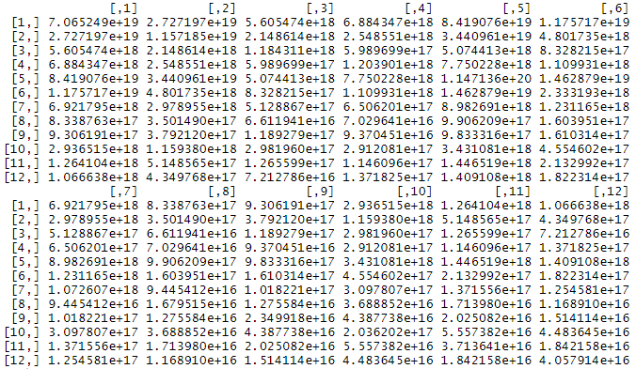
Research Project: First Results
Market Cap covariance matrix
Volume Traded covariance matrix

Slide 16
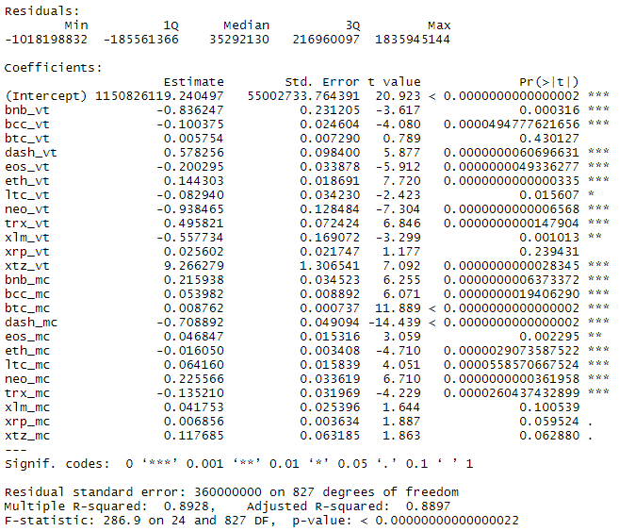
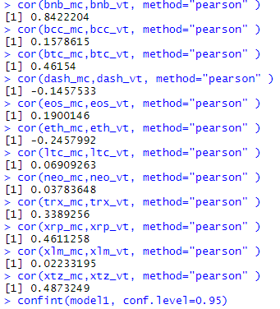
Research Project: First Results

Slide 17
Research Project: Machine Learning Models
- Monte Carlo Simulation

Slide 18
Research Project: The Data

Slide 19
Research Project: The Data

Slide 25
Sources:
Coinmarketcap: https://coinmarketcap.com/

